Slide 2
How to build a story generator application for children with .NET MAUI and Microsoft Azure
Héctor Pérez

Slide 3
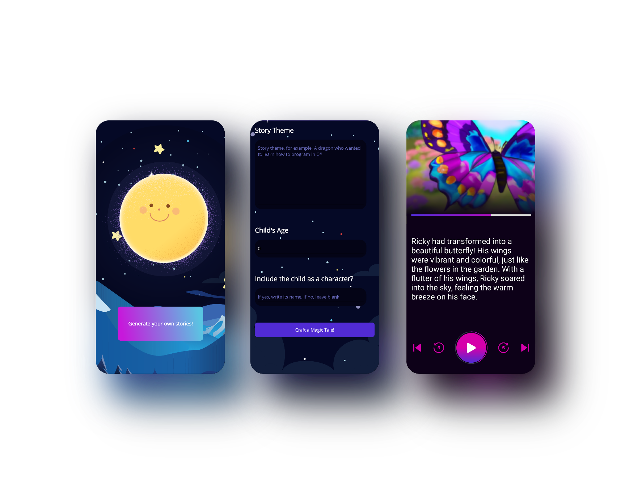
What are we going to build?

Slide 4
What are we going to build?
.NET MAUI
Custom Controls
Animations
Gradients
Audio Player
ASP.NET Web API
Semantic Kernel
Dall-E Image Generation Service
Azure Text to Speech

Slide 5

Step 1 - Creating the home screen - Parallax effect

Slide 6
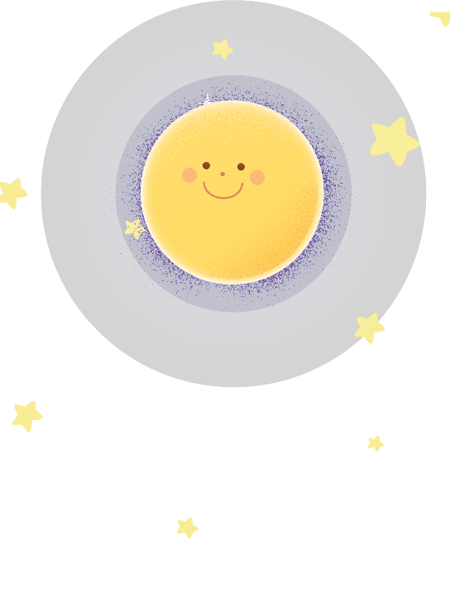
Step 1 - Creating the home screen - Parallax effect

Slide 7

Step 1 - Creating the home screen - Parallax effect

Slide 8

Step 1 - Creating the home screen - Parallax effect

Slide 9
Step 1 - Creating the home screen - Parallax effect

Slide 10
Demo
Step 1 - Creating the home screen - Parallax effect

Slide 11
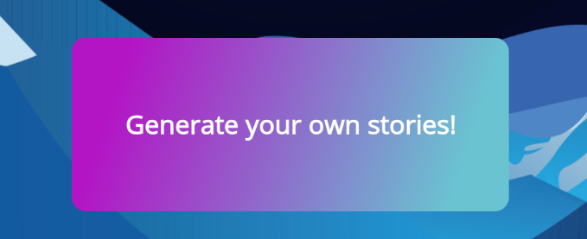
Step 2 – Add a gradient button

Slide 12
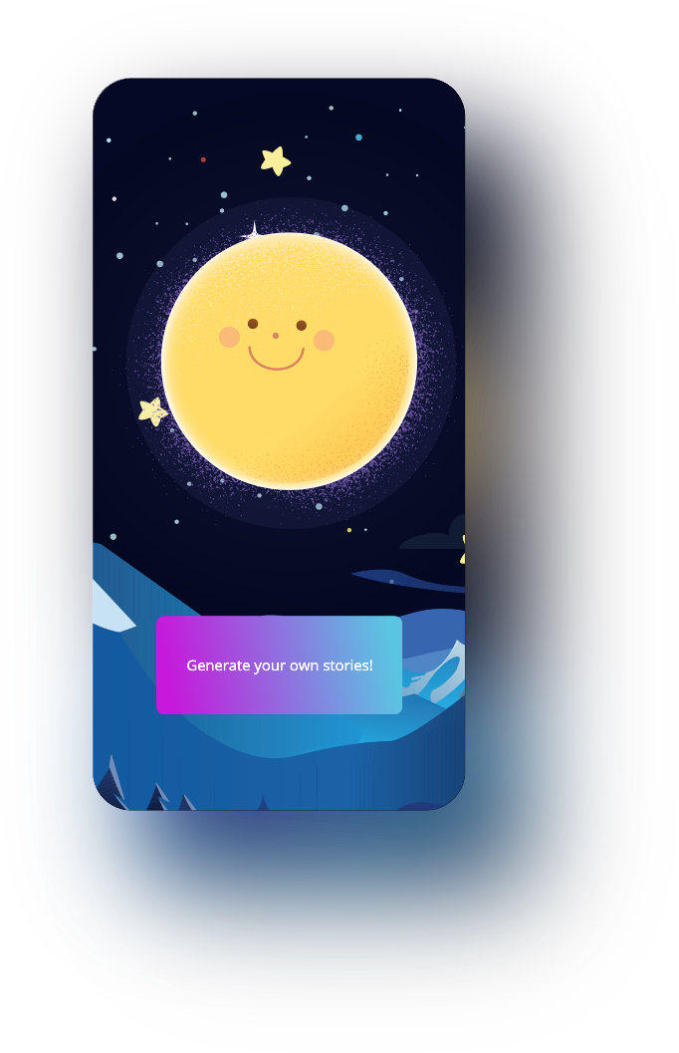
Step 2 – Add a gradient button

Slide 13
Demo
Step 2 – Add a gradient button

Slide 14
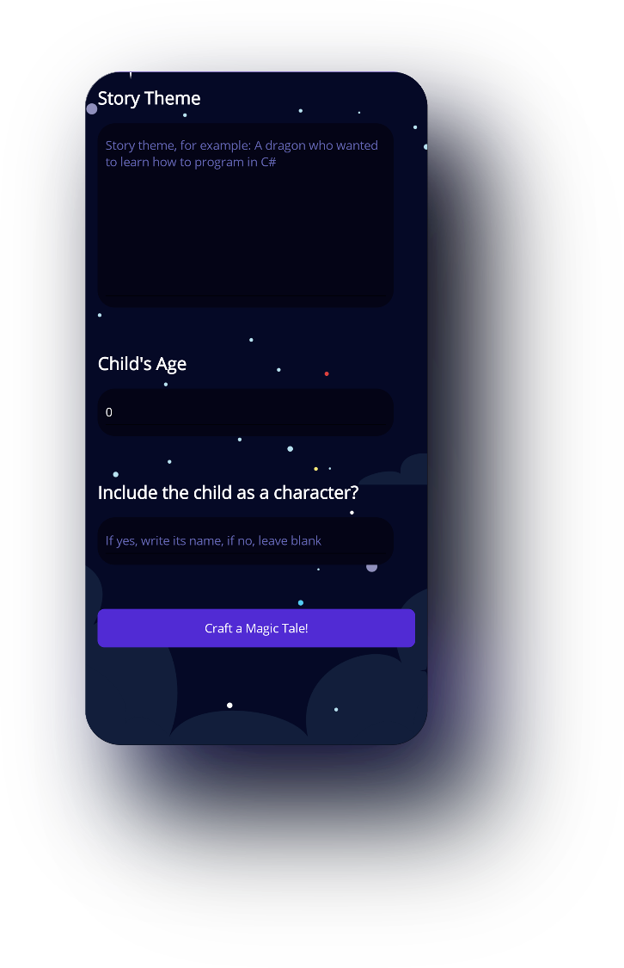
Step 3 – Adding the story description page

Slide 15
Demo
Step 3 – Adding the story description page

Slide 16
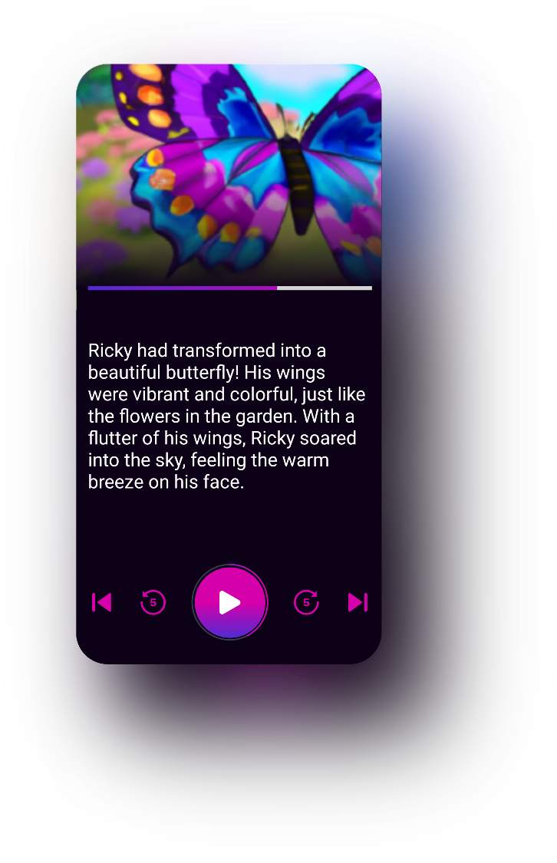
Step 4 – Creating the story player

Slide 17
Demo
Step 4 – Creating the story player

Slide 18
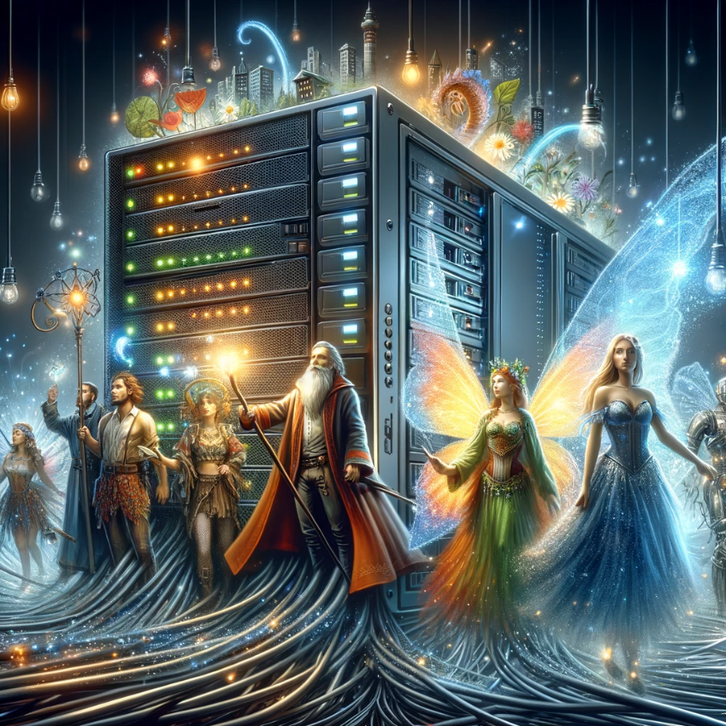
Step 5 – Creating the story generator service

Slide 19
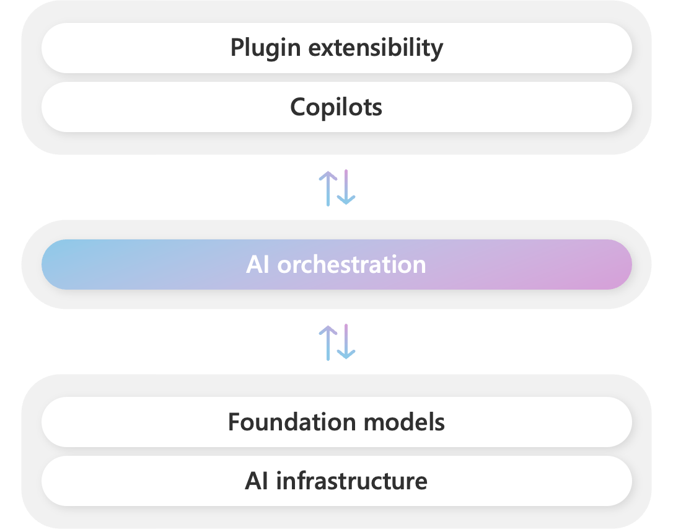
Semantic Kernel

Slide 20
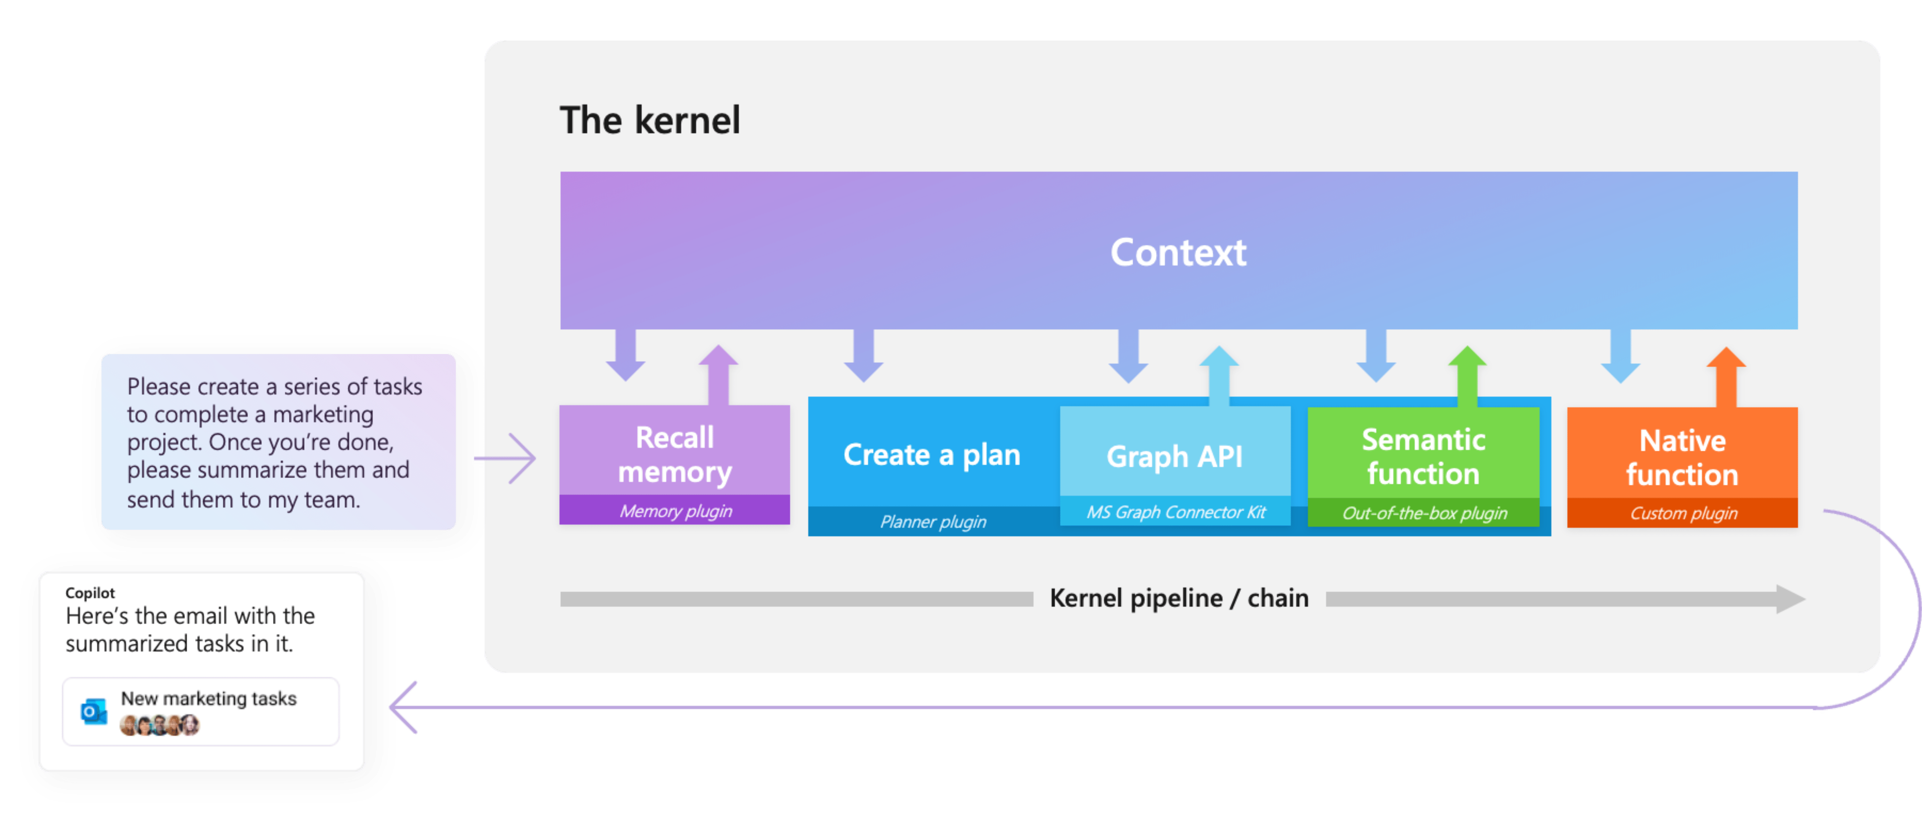
Semantic Kernel

Slide 21

Azure Text to Speech

Slide 22
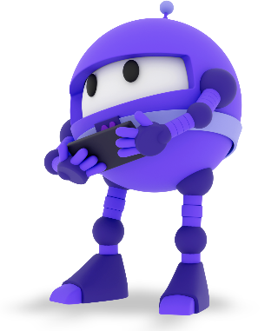
Resources – Thank you!
@hprez
https://devs.school/story-generator
https://www.youtube.com/@devsschool
https://github.com/jsuarezruiz
https://learn.microsoft.com/en-us/semantic-kernel/overview/
https://github.com/mono/SkiaSharp

